Slide 1
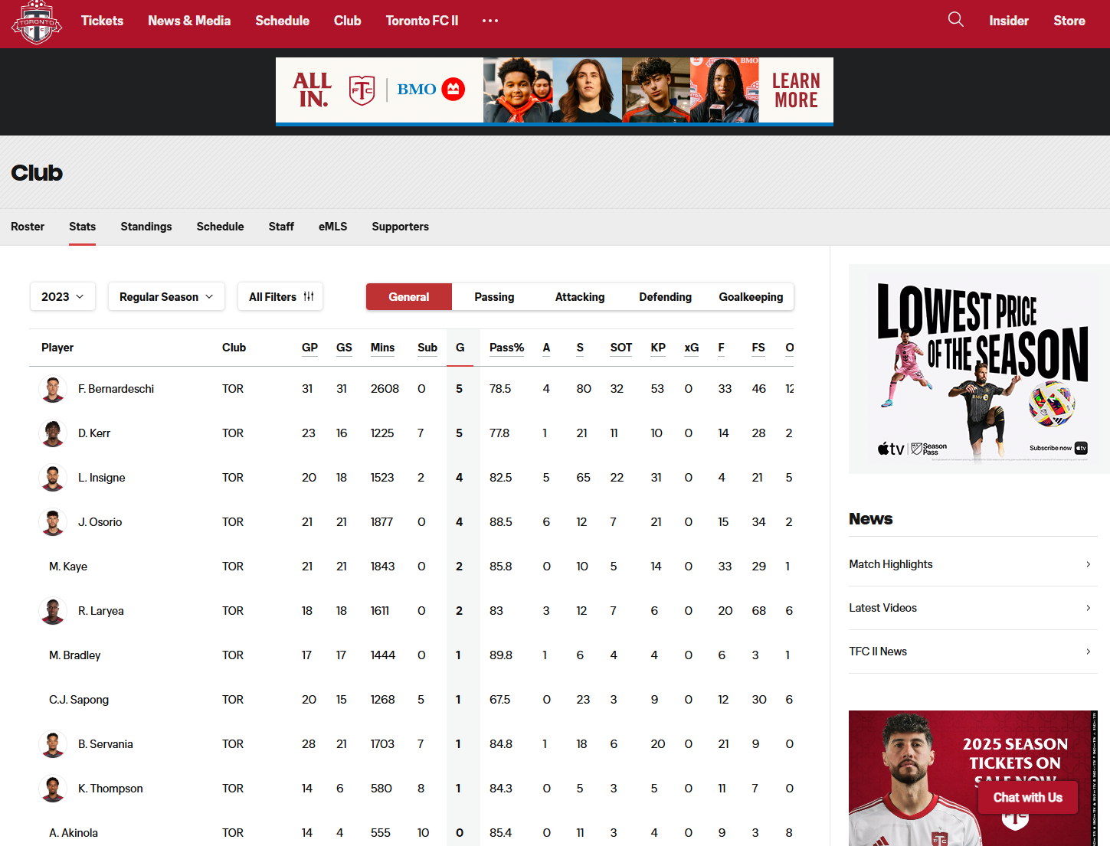



AI-DRIVEN
GAME INSIGHTS
Enhancing Strategic
Planning with Data
Week 8
Notes:
Welcome to our Presentation for Week 8

Slide 2

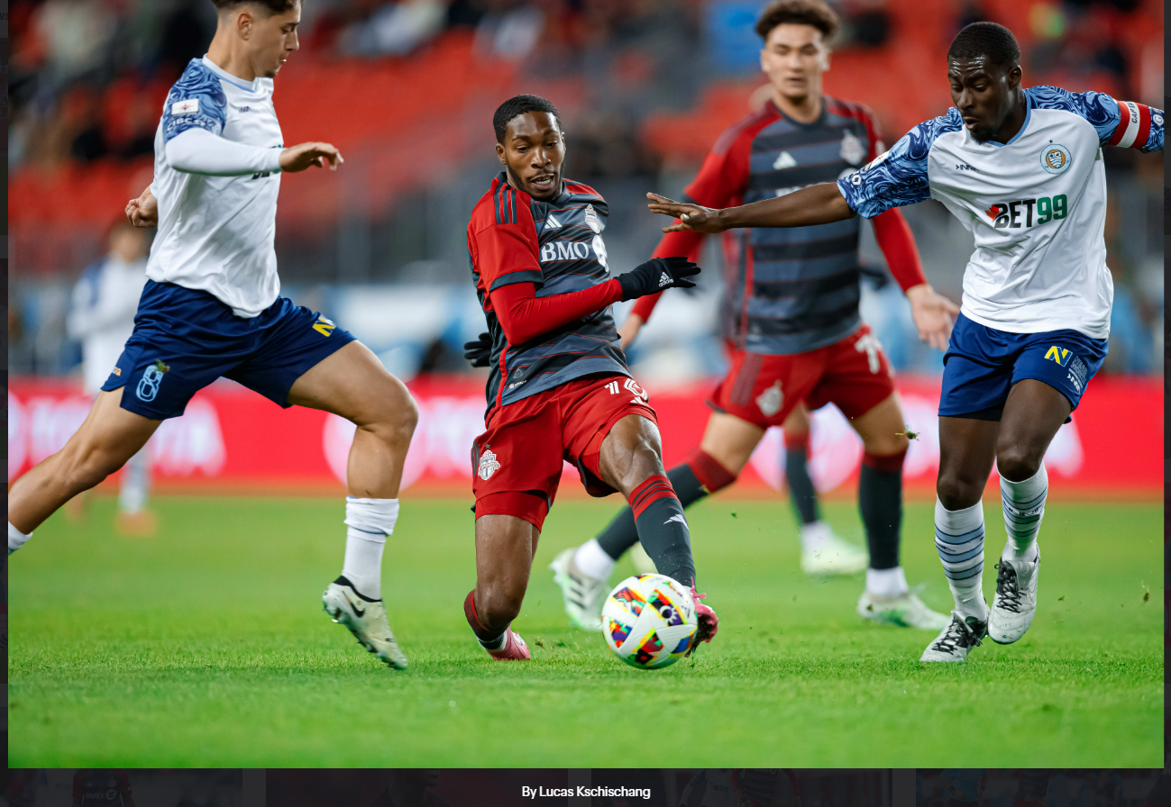






TEAM MEMBER
CHIBUIKE OKOROAMA
VENKATA MANISH
KATRAGADDA
PRESCILA MORA
MOHAMED AFTHAB
Notes:
We are Cooper Incorporate, Chibuike, Manish, Afthab and me Prescila will be presenting for this week.

Slide 3




KEY FACTS
GAME WINNING STATISTICS
2024 Season
Toronto FC has an average
11 wins
3 draws
16 losses
placing them
8th out of 29 teams in the MLS Table
winning 37% of their matches
CANADIAN CHAMPIONSHIP
SUPPOTER’S SHIELD
2009, 2010, 2011, 2012, 2016, 2017, 2018, 2020
Best regular season record
8 TIMES
2017
Notes:
TFC’s current standing reveals significant room for improvement, with a 37% win rate. This highlights the urgency for advanced analytics to analyze opponents, refine strategies, and increase their chances in the upcoming games.
Toronto Football Club or TFC for short has a strong historical performance in the MLS Major League Soccer, with years where they demonstrated high-caliber gameplay. However, the current season is a challenge, and there’s a need for a data-driven approach to regain their competitive edge.

Slide 4

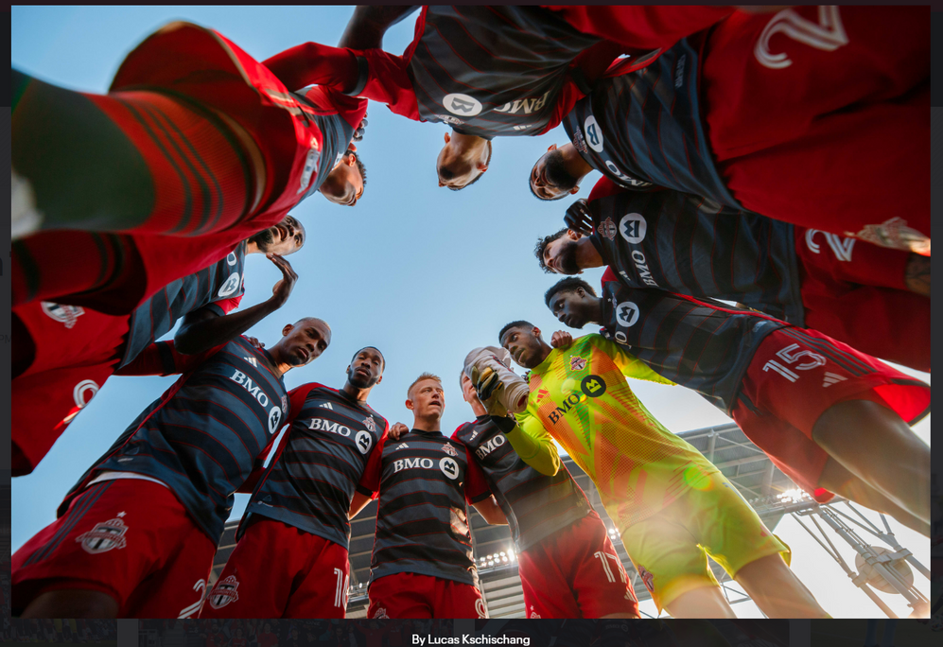

OBJECTIVE
IDENTIFY
KEY
FEATURES
PICK
SPECIFIC
ML
PRESENT
ACTIONABLE
INSIGHTS
of
Opponents’
playing
Styles
for
Toronto
FC
using a
tailored
machine
learning
model
Notes:
The objective here is clear: Identify Key features, Pick specific ML, Present actionable Insights.
To use data to understand the intricacies of the opponent’s strategies and extract actionable insights using machine learning. This will enable Toronto FC to better adapt and outsmart their opponents on the field.

Slide 5
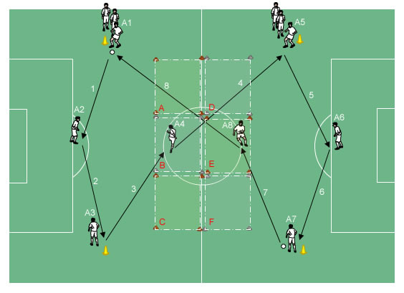
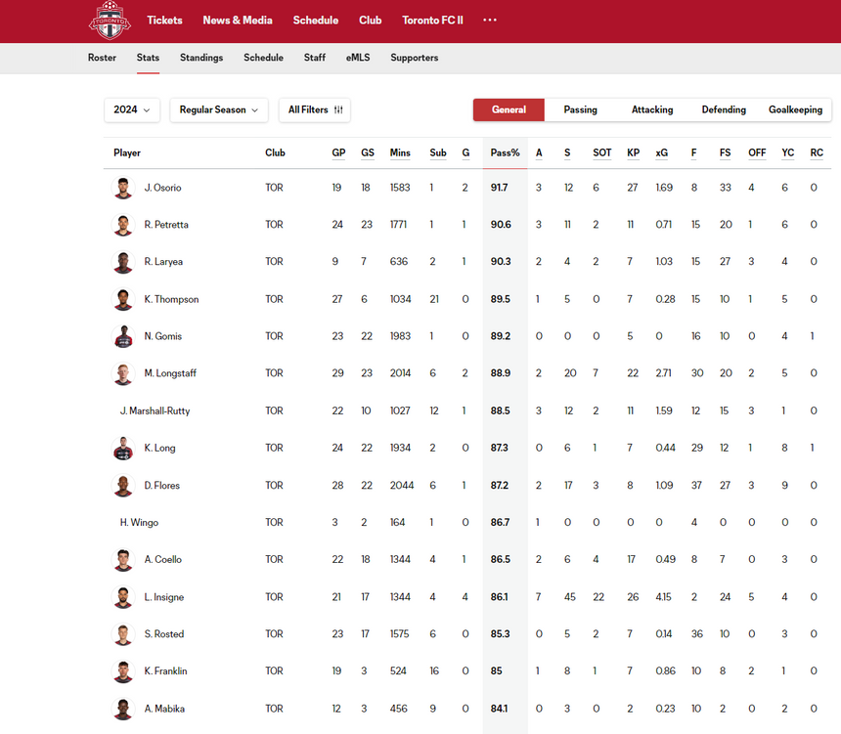

IDENTIFY
VALUABLE
DATA
Gather data from match statistics and player metrics
Identify historical trends and predictive patterns
Corner Kicks
data to identify key patterns
Data comes in both structure and unstructured
https://www.mlssoccer.com/stats/
https://www.torontofc.ca/stats/
Notes:
The approach revolves around gathering the right data from a variety of sources and different metrics.
Explain how every piece of data, from corner kicks to player stats, is a potential goldmine for identifying patterns in opponent gameplay.

Slide 6
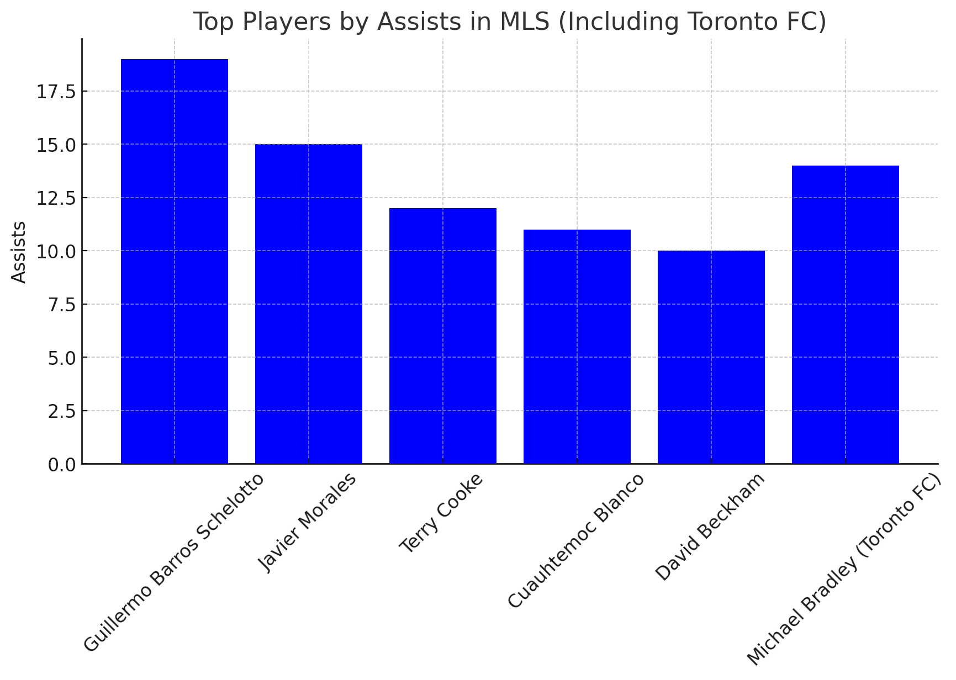

FEATURES
PLAYER-LEVEL
Assists
Pass Completion Rate
Tackles Won
Shots on Target
Field Movement
Speed
Stamina
Strength
Notes:
Identified Key Features, Player stats like assists, stamina, and passing accuracy are crucial for understanding both individual performances and their impact on the team’s results. These metrics feed into the models to refine predictions of game outcomes.
This charts shows the Assists by player so we can have an idea on the metrics.

Slide 7
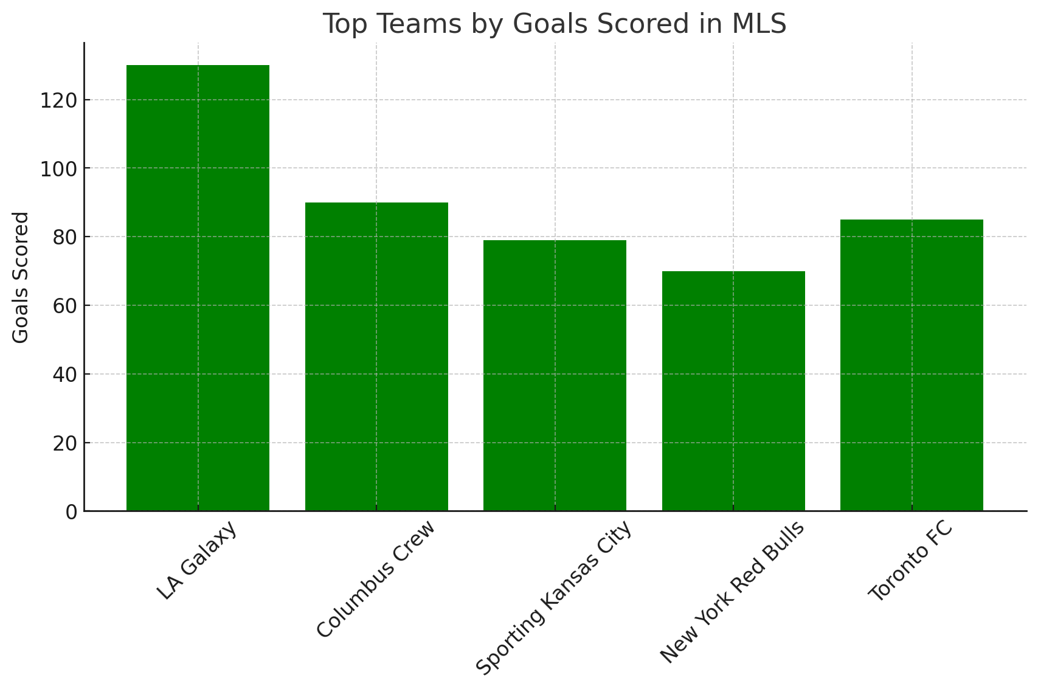

FEATURES
TEAM-LEVEL
Formation frequency and variations
Goal Score
Ball Possession
Attacking Patterns
Defensive strategies
Offensive effectiveness
Defensive effectiveness
Notes:
On a team level, factors like formation frequency and ball possession can reveal much about a team’s tactical inclinations. Our models analyze this data to determine which formations lead to wins and when defensive strategies are most effective.

Slide 8
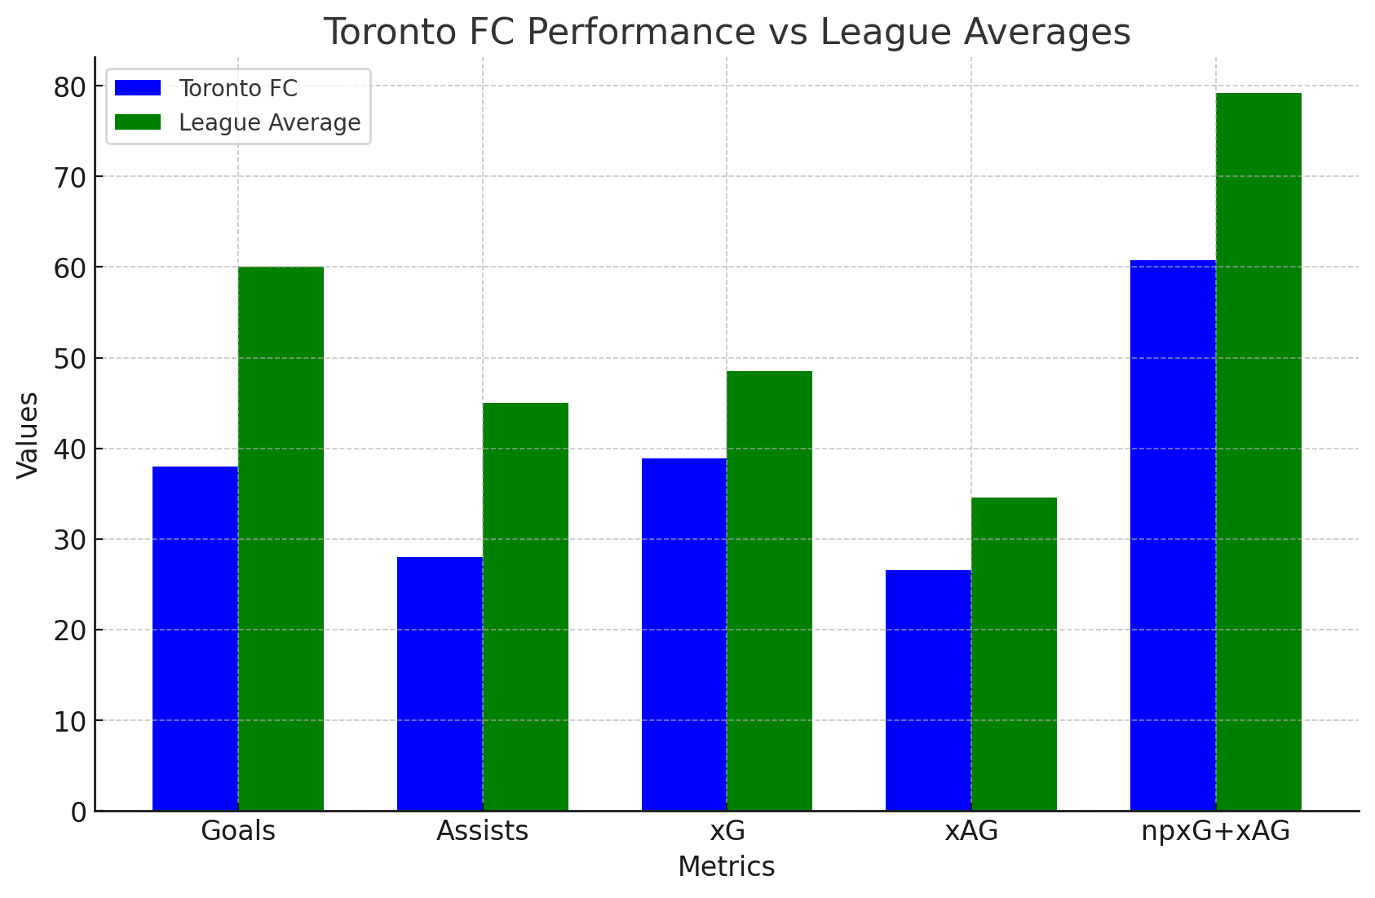
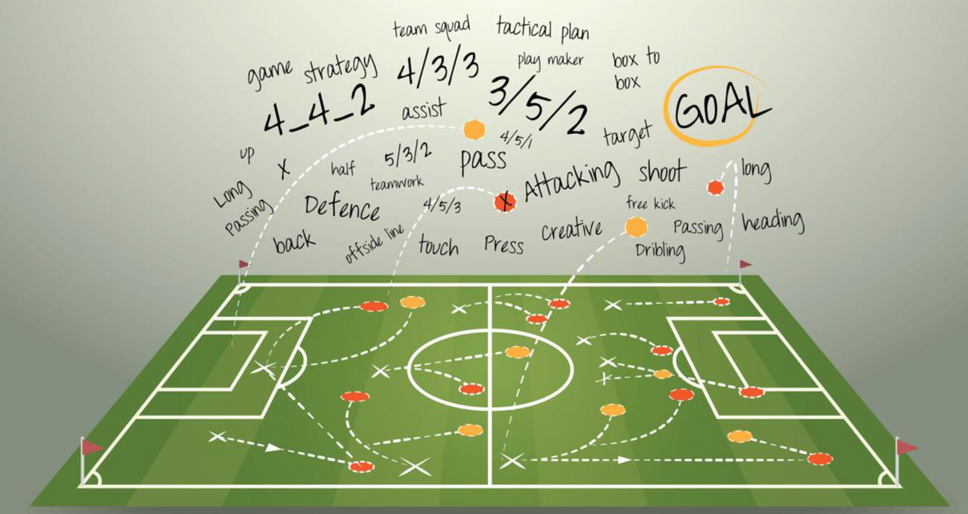

FEATURES
MATCH CONTEXT
Home/away performance differences
Performance against different playing styles
Weather conditions and their impact on team performance
Time-based performance (e.g., first half vs. second half, performance in final minutes)
Notes:
Contextual factors such as home vs. away performance, weather conditions, and timing play a crucial role. For example, understanding how Toronto FC performs in the last minutes of a match gives insights into the team’s endurance and ability to close out games.

Slide 9
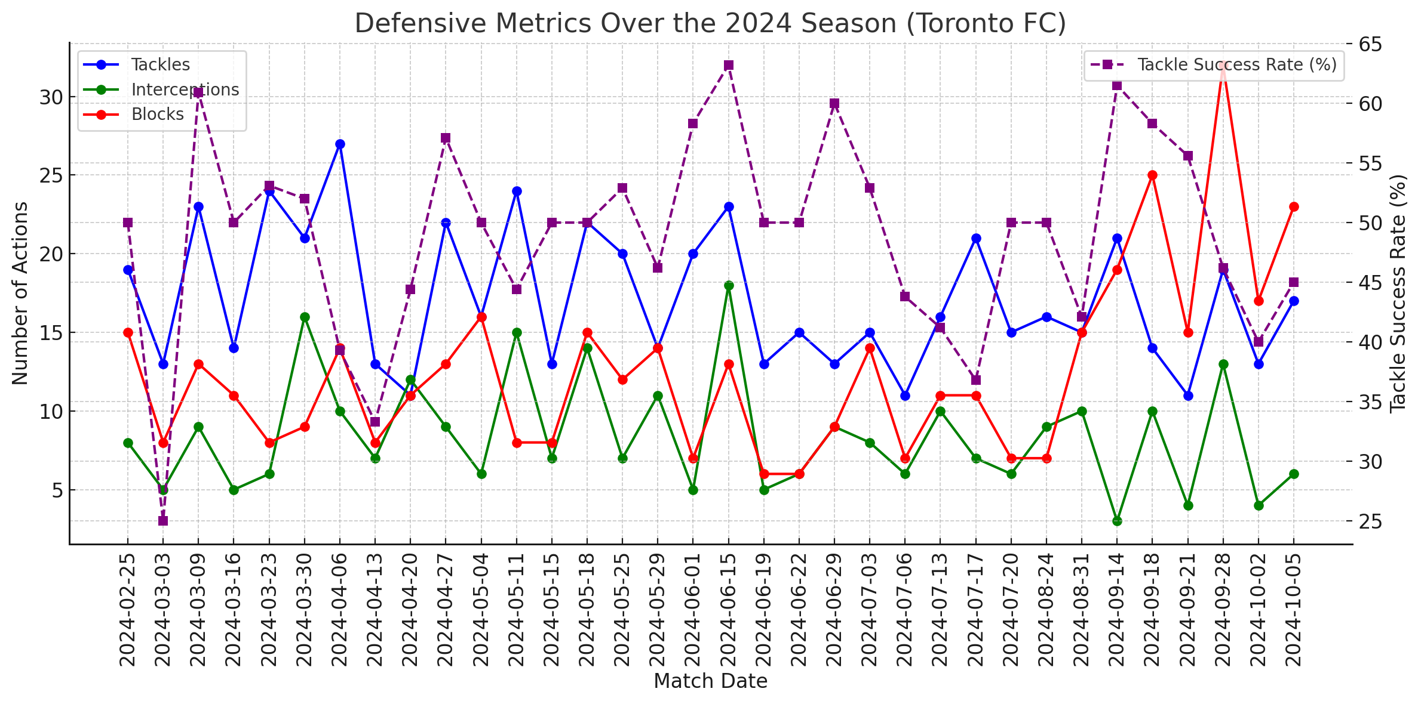

FEATURES
LEAGUE-WIDE
Formation frequency and variations
Ball Possession
Attacking Patterns
Defensive strategies
Offensive effectiveness
Defensive effectiveness
Notes:
Toronto FC’s defense metrics show how the team performs across tackles, interceptions, and blocks throughout the season.
Higher tackle success rates mean stronger defense. By watching these patterns, Toronto FC can identify when to strengthen defense or adjust tactics, helping the team stay effective and balanced on the field.

Slide 10
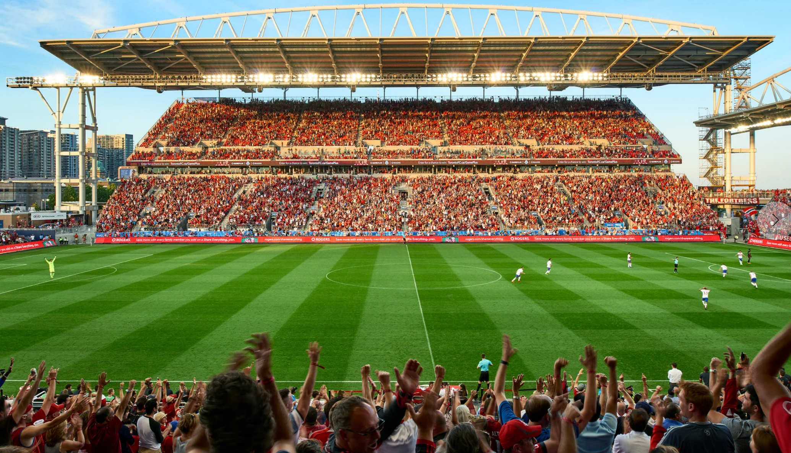
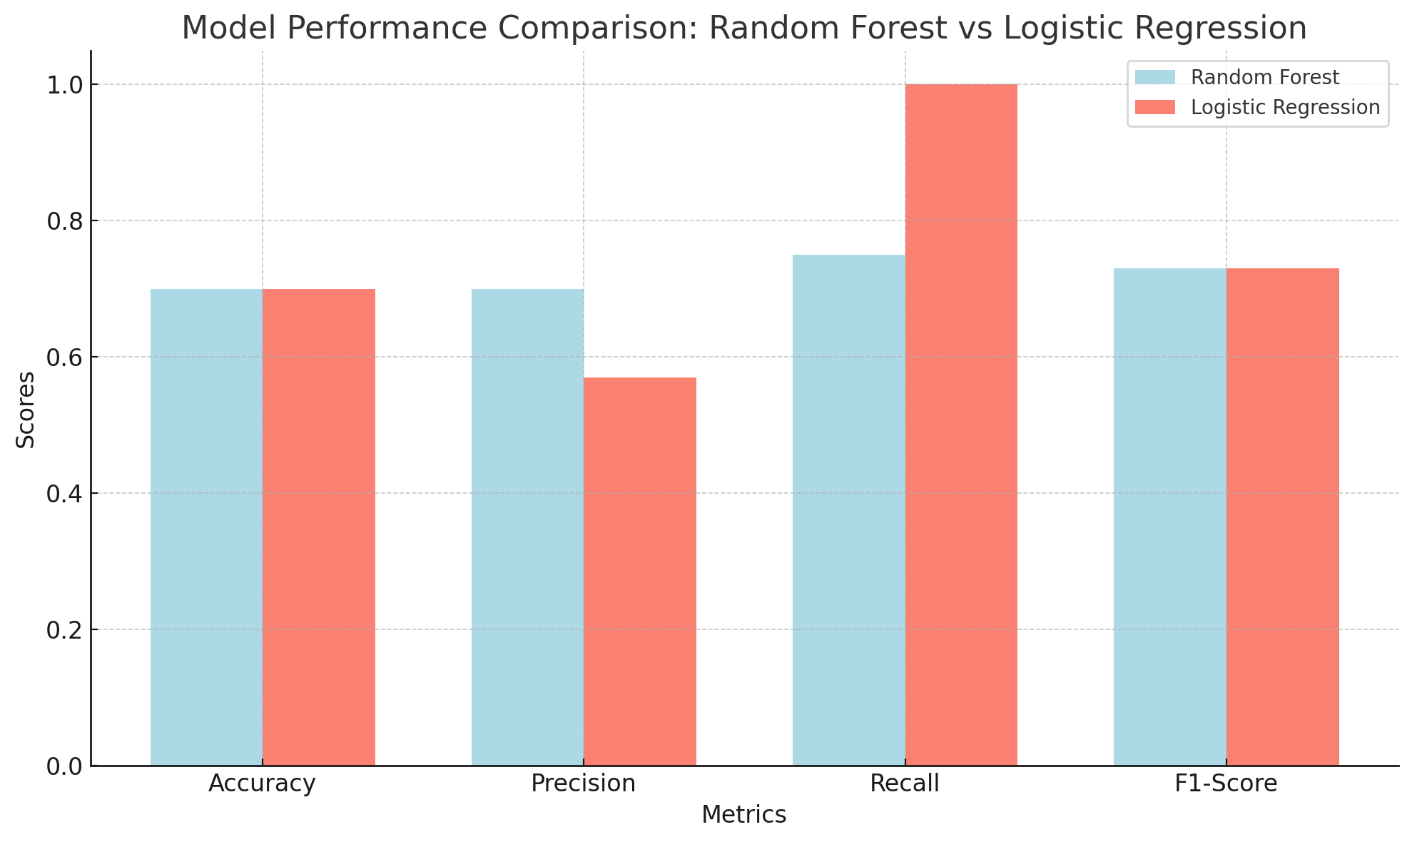

EVALUATE
ML
Random Forest
Consistent performance across all metrics
Logistic Regression
Strong recall for Loss/Draw, weaker precision
Accuracy
Both models perform well at 70%
Precision (Win)
Random Forest outperforms at predicting wins
Recall (Loss/Draw)
Logistic Regression excels at detecting Loss/Draw
Notes:
We tested two models for predicting game outcomes: Random Forest and Logistic Regression.
Random Forest has an accuracy of 70%, meaning it correctly predicts the outcomes of 7 out of 10 games. It’s also 80% precise when predicting wins and catches 75% of losses or draws. Overall, it’s balanced and dependable.
Logistic Regression also has a 70% accuracy. However, it’s better at catching losses and draws with 100% recall, but its precision is a bit lower at 57%.
We chose Random Forest because it’s consistently strong across all areas, making it the best fit for Toronto FC’s tactical planning.

Slide 11
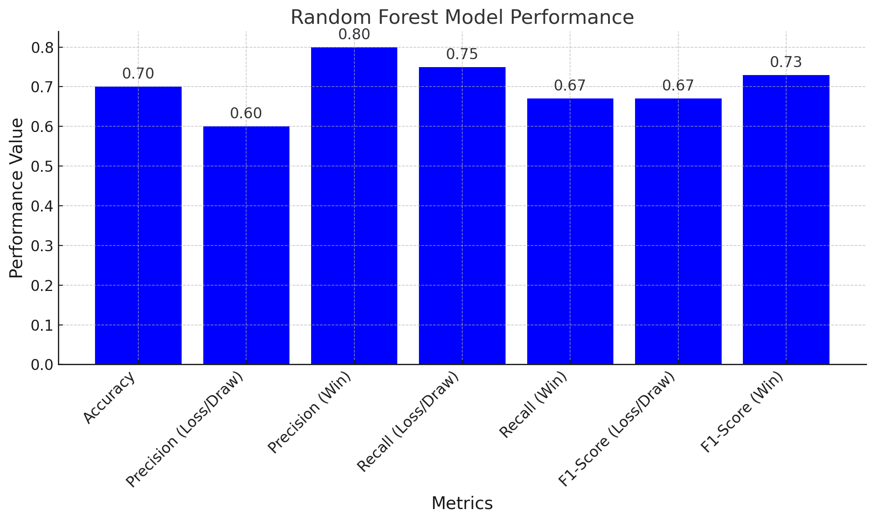

SPECIFIC ML
PICK
Accuracy
Correct 7 out of 10 times
Precision (Wins)
Strong at predicting wins
Precision (Loss/Draw)
Moderate accuracy
Recall (Wins)
Captures most wins
Recall (Loss/Draw)
Strong at catching Loss/Draw
F1-Score (Wins)
Reliable for wins
F1-Score (Loss/Draw)
Reliable for Loss/Draw
Notes:
Here’s a breakdown of the Random Forest model's performance in predicting Toronto FC’s match outcomes:
Accuracy sits at 70%, meaning 7 out of 10 times, the model correctly predicts the game result.
Precision for Wins is impressive at 80%, while Precision for Loss/Draw stands at 60%. This shows that the model is slightly better at predicting Wins with fewer false positives.
Recall for Wins is 67%, meaning it catches the majority of actual wins, while Recall for Loss/Draw is even stronger at 75%.
Finally, the F1-Scores (a balance between precision and recall) are solid—67% for Loss/Draw predictions and 73% for Wins, showing balanced reliability across both outcomes.
In summary, Random Forest provides a robust, balanced performance across key metrics. It consistently predicts both wins and loss/draw scenarios, giving Toronto FC reliable insights to fine-tune their strategies.

Slide 12



ACTIONABLE
INSIGHTS
Boost Confidence in Winning Plays
Prepare for Risk
Balanced Predictions
Data-Driven Decisions
Notes:
Boost Winning Confidence: The model’s precision helps Toronto FC focus on winning strategies.
Prepare for Risk: High recall warns the team when they need to tighten defense.
Balanced Predictions: The model offers reliable insights for different match scenarios.
Make Data-Driven Decisions: Toronto FC can create effective strategies based on solid predictions.

Slide 13



DRIVING SUCCESS FORWARD
Toronto FC will have an edge to win championships by leveraging advanced analytics to empower AI-driven insights, optimize performance, and stay ahead of the competition
Notes:
In conclusion, leveraging AI to extract game insights will provide Toronto FC with a competitive edge. By understanding the opponent’s tactics, formations, and player tendencies, Toronto FC can prepare better strategies and improve their chances of winning upcoming matches.

Slide 14
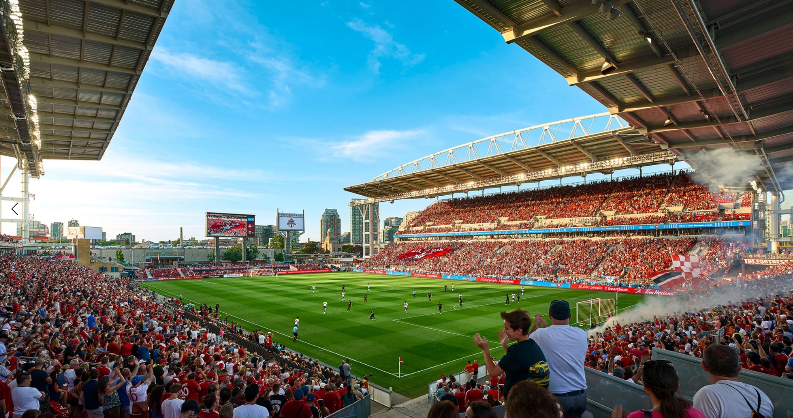

THANK
YOU
REFERENCES
Enhanced Sports Predictions: A Comprehensive Analysis of the
Role and Performance of Predictive Analytics in the Sports Sector
| Wireless Personal Communications (springer.com)
List of Toronto FC records and statistics - Wikipedia

